Slide 1
Iron Count
Mobile Workout Classifier and Rep Counter
Aren Mizuno, Devyani Rastogi, Kennedy Damtse, Rohan Muralidhar
Spring 2026
ADSP 32023 – Advanced Computer Vision Using Deep Learning
Notes:
Aren

Slide 2
Table of Contents
Meet the Team
Business Problem
Exploratory Data Analysis
Pre-Processing
Classification Solution & Results
Rep Counting Solution & Results
Application Architecture and Demo
Challenges
Future Steps
ADSP 32023 – Advanced Computer Vision Using Deep Learning
Notes:
Aren

Slide 3

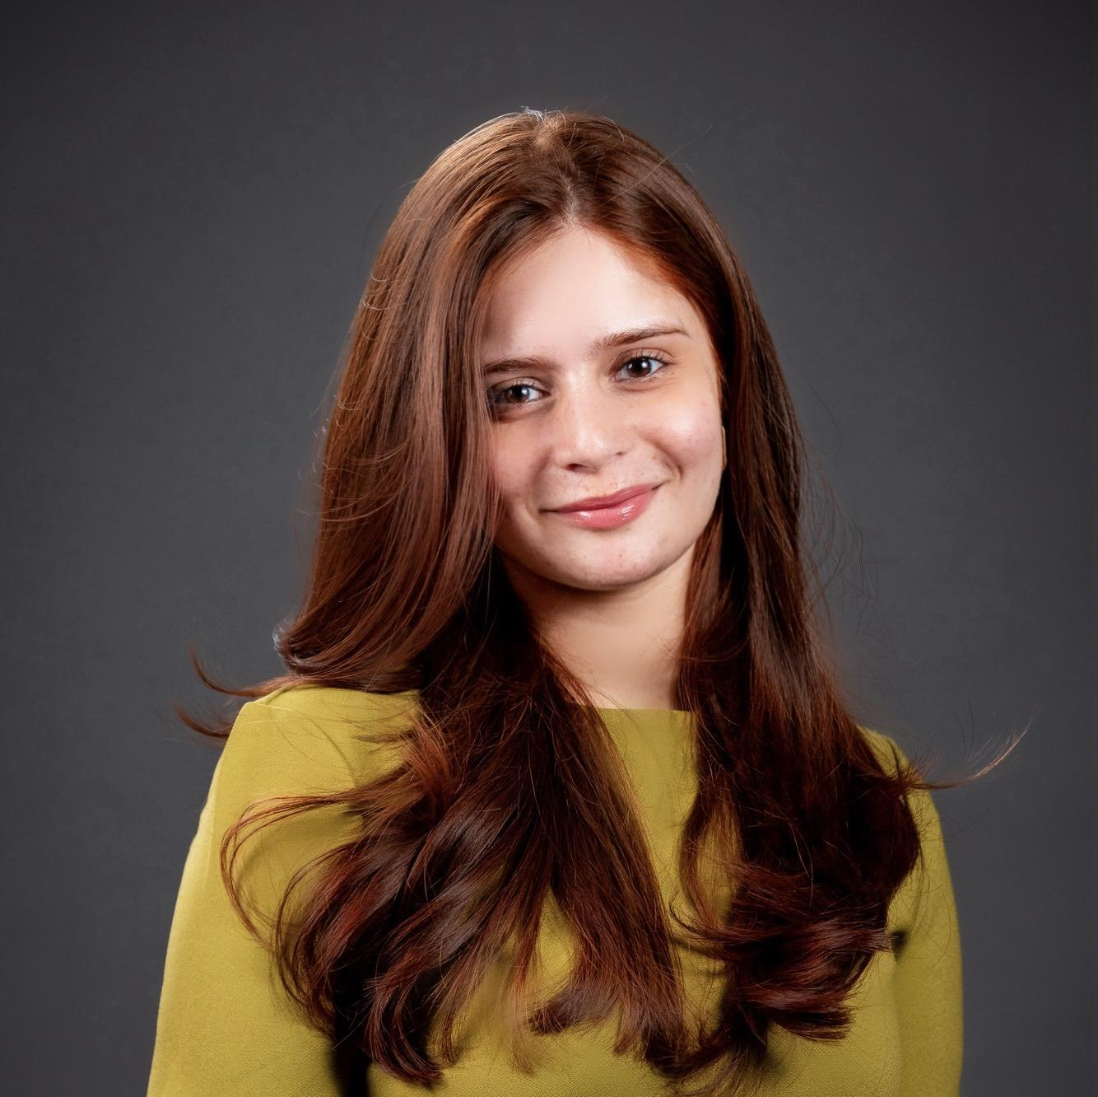


Meet the Team
Aren Mizuno
Devyani Rastogi
Kennedy Damtse
Rohan Muralidhar
MS Applied Data Science, UChicago
BA Data Science & Business Economics, UChicago
Data Science Intern, Actelligent
Data Science Intern, Morningstar
MS Applied Data Science, UChicago
BA Economics and Data Science, NYU
Data Science Intern, United Nations
MS Applied Data Science,
UChicago
BA Political Science & Data Science, The College of Wooster
Data Science Intern, Goodyear
MS Applied Data Science,
UChicago
BS Data Science, Purdue University
AI/ML Intern, Dassault Systemes
Data Science Intern, Kens Foods
ADSP 32023 – Advanced Computer Vision Using Deep Learning
Notes:
Aren

Slide 4
Business Problem
Users often lose track of repetitions during workouts
Improper Workout form can also increase the risk of injury
Current fitness applications lack accurate real-time visual analysis
Gym users need intelligent systems capable of automated exercise monitoring
Goal: AI- based fitness assistant that uses a mobile camera to track rep counts and classify workouts
ADSP 32023 – Advanced Computer Vision Using Deep Learning

Slide 5
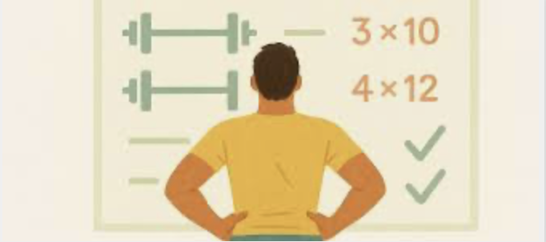
Problems Addressed
Exercise Classification
Identify exercises such as squats, push ups, lunges, curls etc
Rep Counting
Detect repetitive motion cycles and estimate rep count in real time
ADSP 32023 – Advanced Computer Vision Using Deep Learning

Slide 6
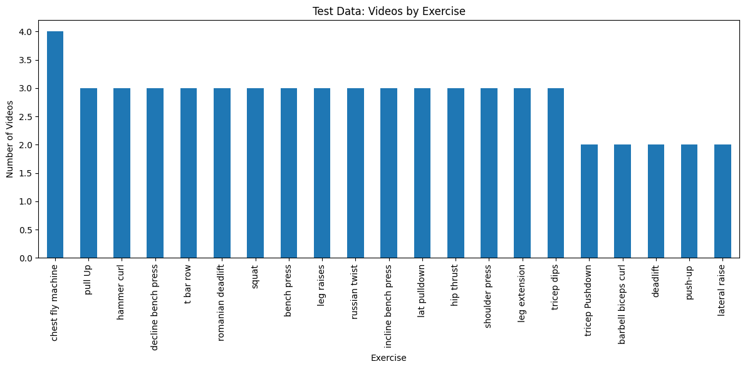
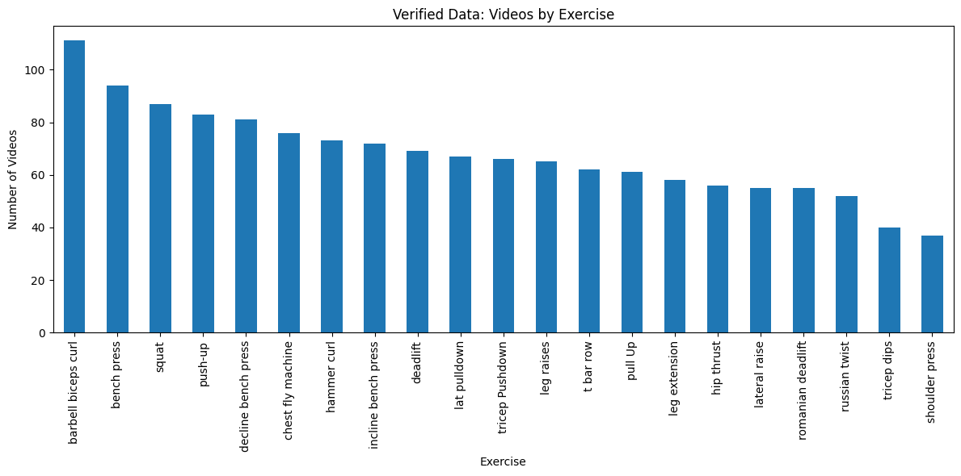
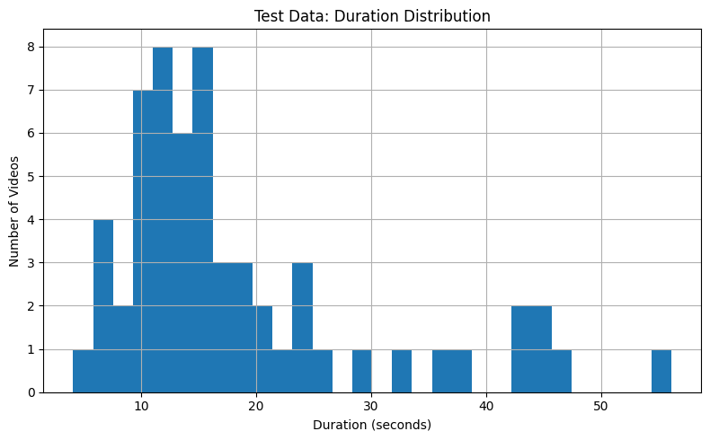
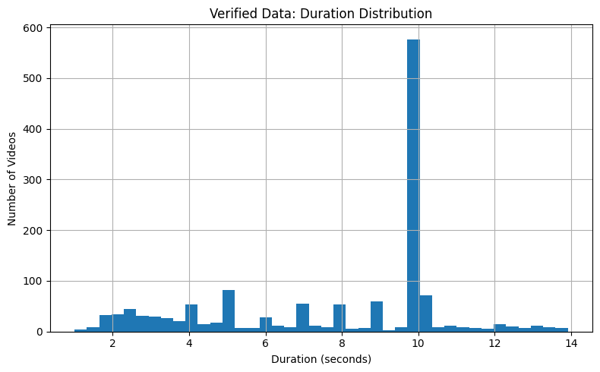
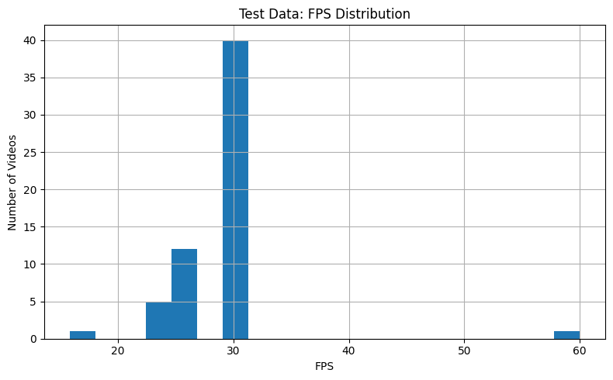
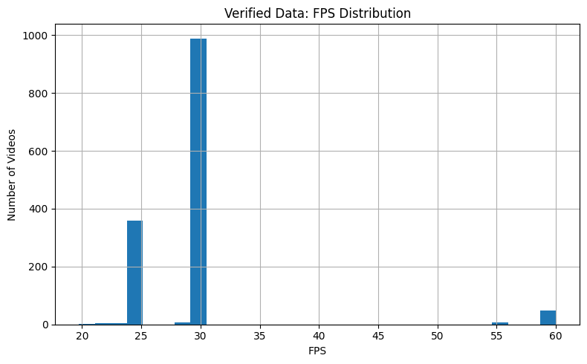
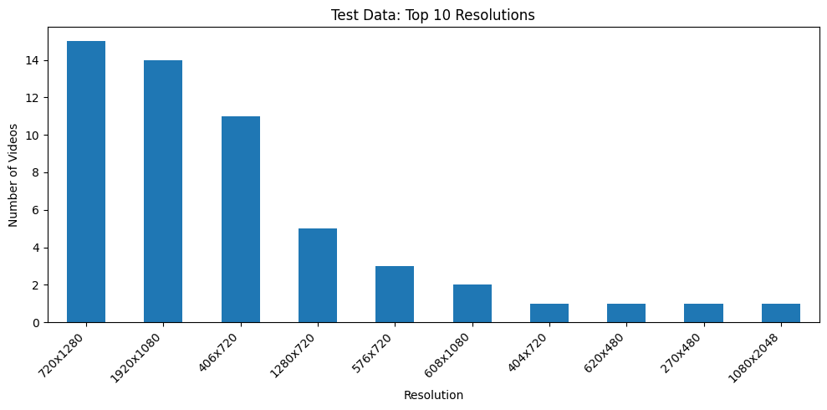
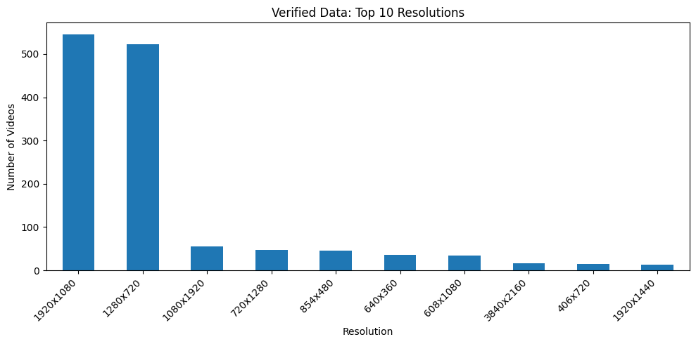
EDA
Dataset Overview:
Source
Kaggle Gym Workout/Exercises Video
Additional
No corrupted videos
22 exercises (removed planks)
Test/Train Split
Train/Verified (1,571 videos):
Cleaned and segmented exercise clips (10–13s max)
817 videos from Workout/Exercises Video dataset (Hasyim Abdillah)
754 videos crawled from YouTube
Test (61 videos):
61 noisy real-world videos
ADSP 32023 – Advanced Computer Vision Using Deep Learning
Notes:
Devyani

Slide 7
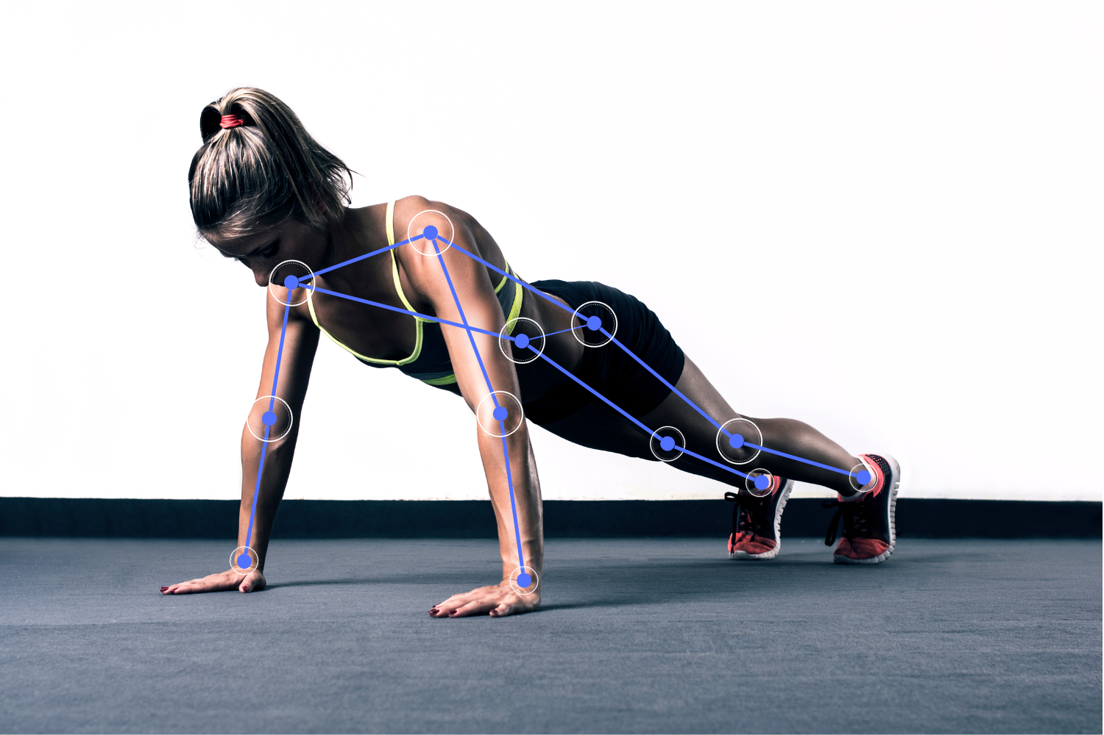
Pre-Processing
MediaPipe Pose Extraction
Extracted 33 pose landmarks per frame
Generated:
Normalized landmark coordinates
Joint-angle features
Geometry/body-position features
Temporal velocity features
Temporal Sequence Construction
Final Feature Representation
Per frame:
150 base pose features
150 velocity features
Final model input:
48 × 300 feature sequences
Built overlapping sliding-window sequences:
48 frames per sequence
50% overlap
Converted videos into fixed-length temporal pose sequences
ADSP 32023 – Advanced Computer Vision Using Deep Learning

Slide 8
Classification Solution
Model | Strength / Purpose | Specific Hyperparameters Tested
CNN | Lightweight temporal feature extraction with fast mobile inference | Channels: (96,128,192,256), (64,128,192,256), (96,160,224,288), (128,160,224,320); kernels: (3,5,3,3), (3,5,5,3), (5,5,3,3); dropout: 0.30–0.40; LR: 1e-3, 5e-4; weight decay: 1e-5
LSTM | Sequential motion modeling using bidirectional temporal learning | Hidden size: 128, 256; layers: 1, 2; dropout: 0.30–0.40; LR: 1e-3, 5e-4; weight decay: 1e-5; bidirectional: True
CNN + LSTM | Combines local motion extraction with temporal sequence modeling | CNN channels: (96,128,192), (96,160,224), (128,160,224); hidden size: 128, 256; layers: 1, 2; dropout: 0.30–0.40; LR: 1e-3, 5e-4; weight decay: 1e-5
TCN | Efficient temporal modeling with dilated convolutions and residual connections | Projection channels: 128, 160; TCN channels: (128,160,192,256), (128,192,224,256), (160,192,224,288); dilations: (1,2,4,8); kernel size: 3, 5; dropout: 0.30–0.40; LR: 1e-3, 5e-4; weight decay: 1e-5
Pose-Based Classification Pipeline
Capture workout video frames
Extract 33 MediaPipe body landmarks per frame
Generate pose, angle, geometry, and velocity features
Construct temporal frame sequences (48 frames)
Feed sequences into deep learning classification model
Training Strategy
5-Fold GroupKFold cross-validation by source video
StandardScaler normalization fit within each training fold
Pose-sequence augmentation for stronger generalization
Weighted cross-entropy loss to handle class imbalance
Adam optimizer with early stopping and LR scheduling
Final retraining using the best CV-selected hyperparameters
ADSP 32023 – Advanced Computer Vision Using Deep Learning
Notes:
The classification pipeline starts by capturing workout video frames and extracting 33 MediaPipe body landmarks from each frame. From these landmarks, we created pose, angle, geometry, and velocity features, which were grouped into 48-frame temporal sequences and fed into deep learning classification models.
For training for the models, we used 5-Fold GroupKFold cross-validation grouped by source video to prevent data leakage. We also applied StandardScaler normalization, pose-sequence augmentation, weighted cross-entropy loss for class imbalance, Adam optimization, early stopping, and learning-rate scheduling to improve training stability and generalization. After cross-validation, each final model was retrained using the best-performing hyperparameters.
We tested four architectures — CNN, LSTM, CNN + LSTM, and TCN — to compare different approaches. The CNN focused on lightweight and efficient temporal feature extraction for faster mobile inference, while the LSTM modeled sequential movement over time through recurrent hidden states. The CNN + LSTM combined the two strategies, and the TCN used dilated convolutions and residual connections for efficient temporal sequence modeling.

Slide 9
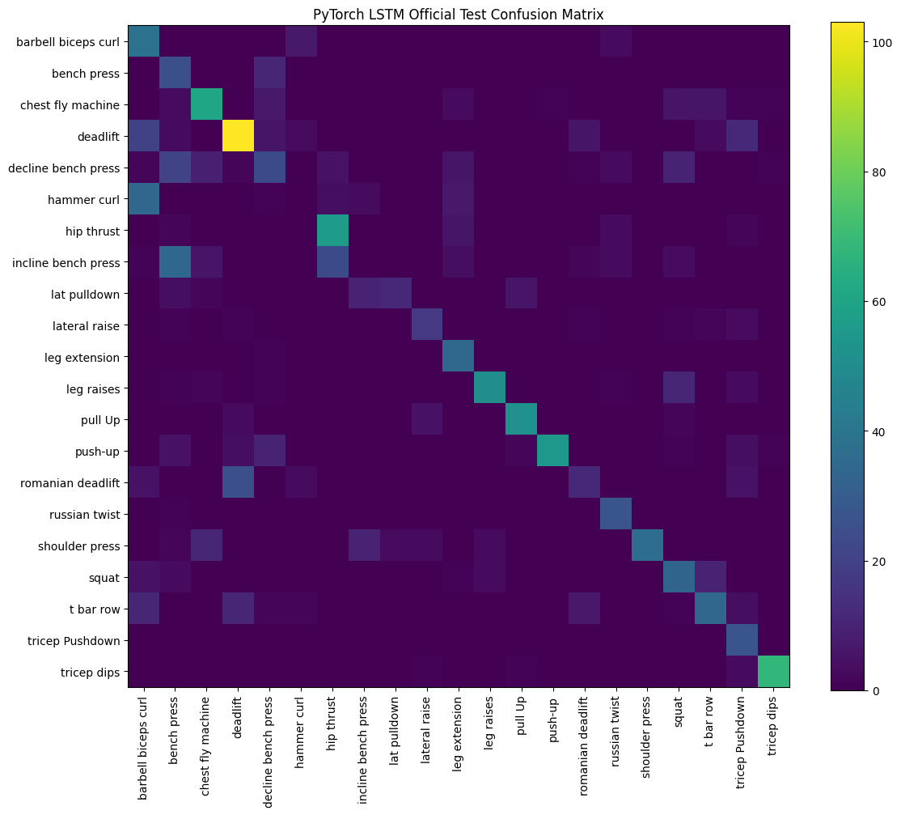
Classification Solution Results
Model | Mean CV Accuracy | Official Test Accuracy
CNN | 88.50% | 57.00%
LSTM | 87.31% | 59.40%
CNN + LSTM | 88.22% | 57.70%
TCN | 88.22% | 57.39%
ADSP 32023 – Advanced Computer Vision Using Deep Learning
Notes:
Here are the final classification results across all evaluated architectures. Overall, all models performed relatively poorly in terms of accuracy on the noisy real-world test set, despite achieving strong training and cross-validation performance. It is important to note that the test set was intentionally noisy and including YouTube text overlays, background movement, varied camera angles, and other visual distractions.
We ultimately selected the LSTM model for deployment because it achieved the strongest official test performance. This was likely because it is capable of capturing longer term memory which is important when movements like squats or curls may initially look similar at a point but change as you actually engage in them.
The confusion matrix showed strong diagonal patterns, indicating that the model was generally successful at correctly identifying many exercises. However, some confusion still remained between biomechanically similar movements, particularly among different bench press variations. Certain exercises, such as hammer curls, were also significantly more difficult for the model to distinguish due to limited motion differences.

Slide 10
Rep Counting Solution
Angle-Based Counting
3D joint angle per frame averaged across both sides (elbows for curls/push-ups, knees for squats, hip for deadlifts)
Each exercise maps to a fixed joint and a two-state algorithm with hardcoded up/down angle thresholds
Deterministic and lightweight
Common approach for rep counting
Qualitative tuning of angle thresholds
PCA-Based Counting
Per frame, extract a 12-dimension vector of symmetry averaged joint angles and body-normalized y-coordinates
Fit PCA on 35 training videos per exercise
Select the principal component whose projected time series has the highest periodicity
At inference, project each frame onto that PC to produce a single scalar
Improvements
Smoothing applied to reduce effects of frame-to-frame jitter or noisy pose estimates
Schmitt Trigger requires full crossing (peak + valley) to prevent noise
ADSP 32023 – Advanced Computer Vision Using Deep Learning
Notes:
rohan

Slide 11
Rep Counting Evaluation
Methodology
Qualitative evaluation during app use
Quantitative analysis done through manual test video set evaluation
Per video, run pca / angle rep counting, then enter true rep value
Takeaways
PCA approach outperformed angle calculation in terms of MAE and RMSE
PCA does well for exercises with consistent, low-noise motion cycles
Push-ups, pull-ups, hammer curl, tricep pushdown
Challenges
Occlusion: body parts blocking key landmarks mid-rep cause missing or erratic angle estimates
Pose Discrepancies: MediaPipe landmark confidence degrades when the exercise moves the person partially out of frame or at unusual viewing angles
Approach | n | MAE | RMSE | bias | exact % | within 1 %
PCA | 56 | 2.411 | 3.921 | 2.304 | 44.643 | 50.00
Angle | 54 | 3.944 | 5.852 | -2.167 | 14.815 | 29.63
ADSP 32023 – Advanced Computer Vision Using Deep Learning
Notes:
rohan

Slide 12

Application Architecture and Demo
iOS Application Pipeline – XCode
Component | Role
CameraManager | Captures live camera frames and manages real-time camera processing
CameraPreview | Displays the live camera feed inside the SwiftUI interface
MediaPipePoseManager | Extracts real-time MediaPipe body landmarks from video frames
FeatureExtractor | Converts pose landmarks into engineered pose, angle, geometry, and velocity features
ExerciseClassifier | Runs CoreML LSTM inference on 48-frame temporal pose sequences
RepCounter | Counts repetitions using exercise-specific joint angle heuristics
PCARepCounter | Counts repetitions using PCA-based motion signal analysis
ContentView | Displays the camera preview, predicted exercise, repetition count, workout timer, and workout history
WorkoutRecord | Stores completed workout session history and exercise statistics
WorkoutClassifierLSTM.mlpackage | Deployed CoreML LSTM classification model used for on-device inference
label_names.json | Maps model output indices to exercise labels
mediapipe_scaler.json | Stores normalization parameters used during inference preprocessing
coreml_bundle | Contains deployed CoreML model assets and inference resources
ADSP 32023 – Advanced Computer Vision Using Deep Learning
Notes:
rohan

Slide 13
Challenges
Model Deployment & Architecture Challenges
Classification/Counting Accuracy
TensorFlow LSTM implementation faced compatibility and deployment limitations for mobile integration
Classification and rep counting accuracy was sensitive to camera angle, lighting conditions, occlusions, and body positioning
Solution: Migrated sequence models to PyTorch with CoreML conversion support for iOS deployment
Solution: Expanded training data using a larger workout dataset and evaluated on noisy real-world test videos
ADSP 32023 – Advanced Computer Vision Using Deep Learning
Notes:
This project involved several important technical and modeling challenges. Initially, we attempted to implement the LSTM pipeline using TensorFlow, but encountered compatibility issues with CoreML conversion and iOS deployment. To solve this, we migrated the sequence models to PyTorch, which provided more reliable mobile deployment support.
Another major challenge was classification accuracy and counting in real-world conditions. Model performance was sensitive to camera angle, lighting, occlusions, and body positioning. To improve robustness, we expanded the dataset with additional scraped YouTube workout videos and evaluated the models on noisy real-world test footage to better simulate gym environments. But this could’ve definitely been improved upon in future steps that Devyani will discuss next.

Slide 14
Future Steps
1.
Improved Real-World Robustness
2.
Real-Time Form Correction
3.
Integration with Other Platforms
Connect with other fitness apps, wearables, and even AI Assistant for centralized workout analytics
Joint-angle analysis and movement quality feedback
More training data and advanced models
Result: Better accuracy performance even in crowded-gym
Result: Fewer injuries and safer workout technique
Result: Unified fitness tracking, personalized workouts, and overall improved long-term health insights
ADSP 32023 – Advanced Computer Vision Using Deep Learning
Notes:
Devyani

Slide 15
Thank You
ADSP 32023 – Advanced Computer Vision Using Deep Learning

